Slide 1

INFERNO
RUNNER
Manual

Slide 2

Content:
Game Story
Controls
Gameplay
User Interface
Copyrights

Slide 3
Story:
You are dead but you find yourself awake in hell.
Since you are a disgusting terrible human being, God does not have a place for you in his kingdom.
Even the devil himself is not so sure about you.
He wants you to prove that you are worth his attention by completing challenges in hell - to be welcomed in hell.
If you fail your soul is void.

Slide 4


Controls:
Forward :
Backward :
Left :
Right :
Look Around :
Jump :
Show Map :
W
A
S
D
Space

Slide 5

Controls:
Show Map
Main Menu
Move
Around
Jump
Look
Around

Slide 6
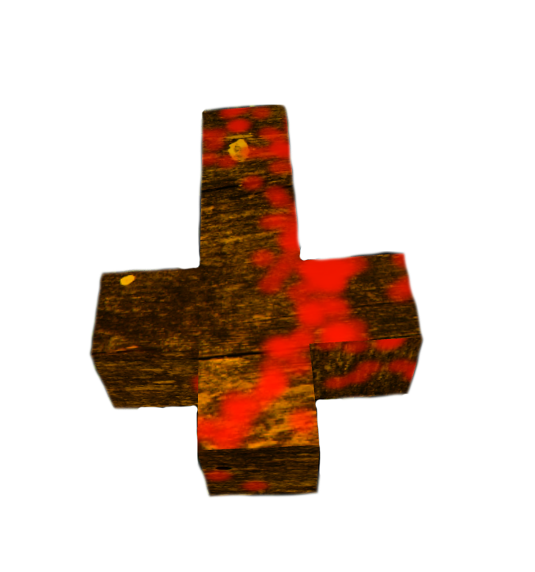
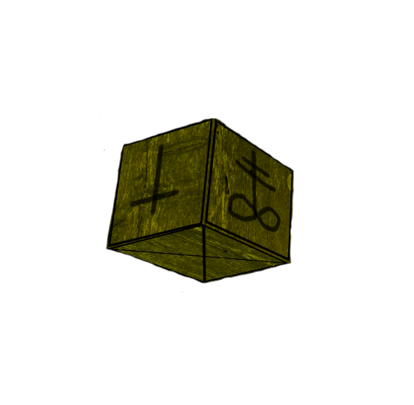
Gameplay:
In order to please the Devil you need to complete challenges in hell. This challenges include reaching a goal – somehow.
At the beginning of each challenge you will be granted 3 lives which is the maximum amount of lives you can own.
You need to navigate your character through different levels, containing: movabale and immovable platforms, enemys, traps, souls, coffins and shops.
You can move between different platforms or single blocks by jumping.
Soul
Block ??

Slide 7
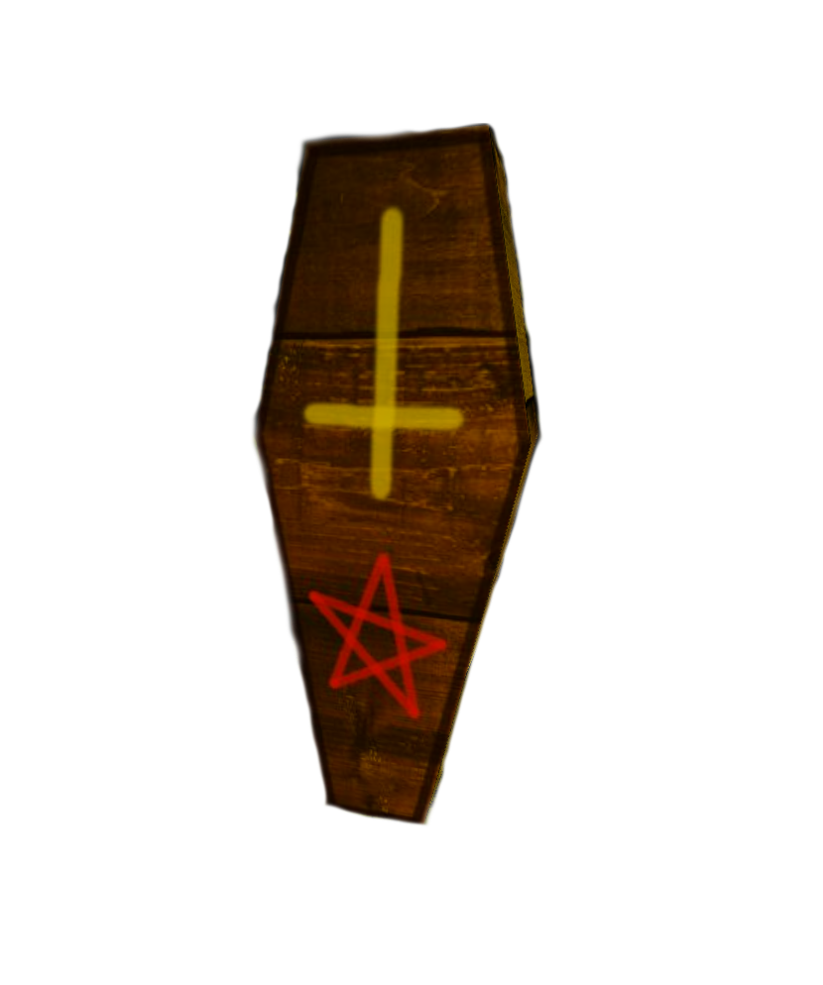
Gameplay:
If you fall into the endless abyss, get attacked by an enemy or be surprised by a trap one of your lives will be lost.
Aswell you will suffer from an injury and blood will be splattered on your field of view.
As long as you have at least one life remaining you will come back to life at the las coffin you visited.
If you have no lives left you’re dead and doomed to attend infinite pain – forever!
Coffin

Slide 8
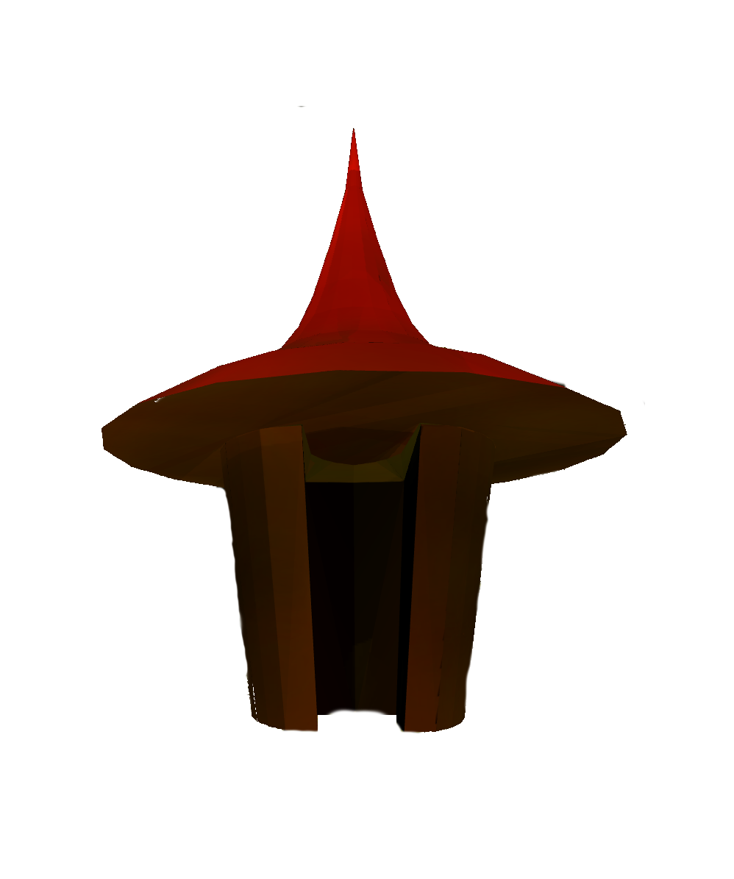

Gameplay:
There are several souls rarely spread among various levels, which you can colltect.
These souls can be used to regain lost lives or to heal your injuries if you spend them in a shop.
If you reach the goal of a level you will continue to the next level.
When you completed all challenges you proved yourself worthy and your soul can be taken to hell…
Shop
Goal

Slide 9
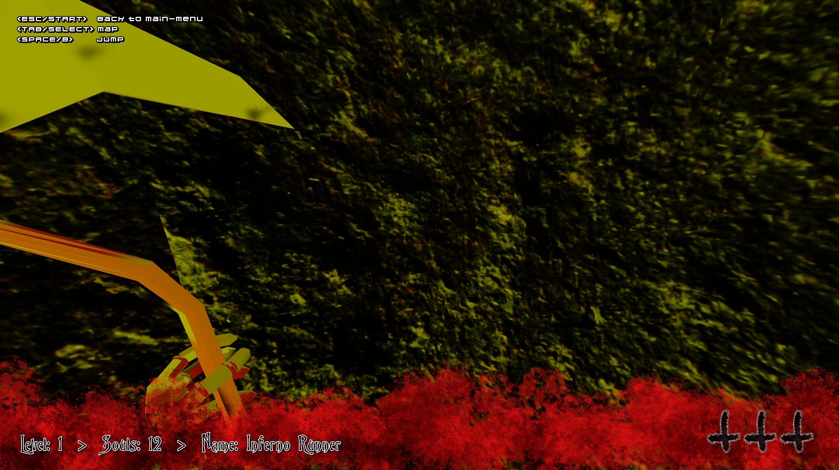
User Interface:
Control hints
Current
level
Livecount
Soulcount
Your name

Slide 10
Copyright:
Models:
“Grim Reaper 1.0” by Eddie Balderas on: https://poly.google.com/view/3Ook4jHoAjW
Textures:
Cross wood texture based on: https://freestocktextures.com/texture/old-wood-board,825.html
All other assets are self made and under create common non-commercial license.
Audio:
lava.mp3: http://www.freesfx.co.uk/info/eula/
door.mp3: http://soundbible.com/1717-Creaking-Door-Spooky.html
walking.mp3: http://soundbible.com/1432-Walking-On-Gravel.html
sigh.mp3: http://soundbible.com/321-Heavy-Sigh.html
poke.mp3: http://soundbible.com/2048-Eye-Poke.html
come-here.mp3: http://soundbible.com/1037-Zombie-Come-Here.html
hell.mp3: http://soundbible.com/1826-Hell.html
scream.mp3: http://soundbible.com/1459-Psycho-Scream.html
creepy.mp3: http://soundbible.com/2165-Creepy-Background.html
demon: http://soundbible.com/162-Demons-Screaming-In-Hell.html
All other assets are self made and under create common non-commercial license.

Slide 11


